Slide 1
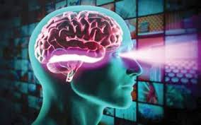
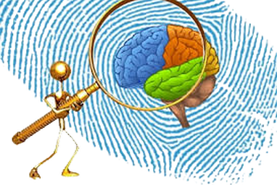
Understand Yourself Scientifically
With DMIT

Slide 2
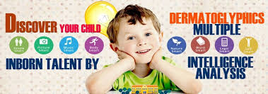
Discover Your Inborn Talent & Potentials

Slide 3

Make your child genius

Slide 4


Get yourself
On right path

